Slide 1
DATA MINING LECTURE 8
Clustering
The k-means algorithm
Hierarchical Clustering
The DBSCAN algorithm

Slide 2
What is a Clustering?
In general a grouping of objects such that the objects in a group (cluster) are similar (or related) to one another and different from (or unrelated to) the objects in other groups
Inter-cluster distances are maximized
Intra-cluster distances are minimized

Slide 3
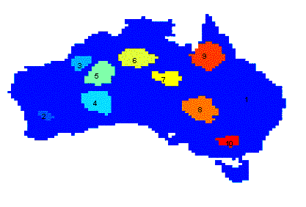
Applications of Cluster Analysis
Understanding
Group related documents for browsing, genes and proteins that have similar functionality, stocks with similar price fluctuations, users with same behavior
Summarization
Reduce the size of large data sets
Applications
Recommendation systems
Search Personalization
Clustering precipitation in Australia

Slide 4
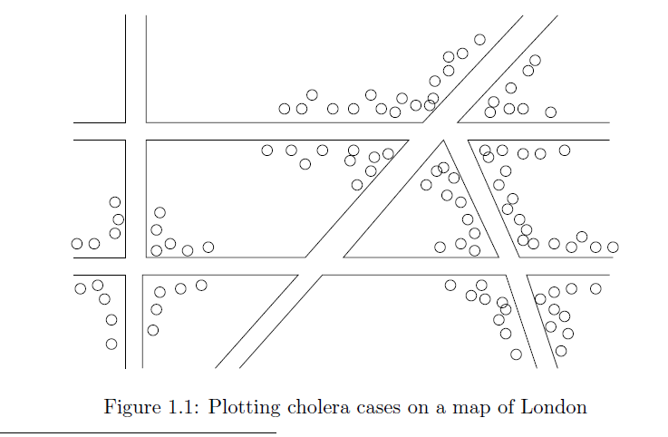
Early applications of cluster analysis
John Snow, London 1854

Slide 5
Notion of a Cluster can be Ambiguous
How many clusters?
Six Clusters
Two Clusters
Four Clusters

Slide 6
Types of Clusterings
A clustering is a set of clusters
Important distinction between hierarchical and partitional sets of clusters
Partitional Clustering
A division data objects into subsets (clusters) such that each data object is in exactly one subset
Hierarchical clustering
A set of nested clusters organized as a hierarchical tree

Slide 7
Partitional Clustering
Original Points
A Partitional Clustering

Slide 8
Hierarchical Clustering
Traditional Hierarchical Clustering
Traditional Dendrogram
Non-traditional Hierarchical Clustering
Non-traditional Dendrogram

Slide 9
Other types of clustering
Exclusive (or non-overlapping) versus non-exclusive (or overlapping)
In non-exclusive clusterings, points may belong to multiple clusters.
Points that belong to multiple classes, or ‘border’ points
Fuzzy (or soft) versus non-fuzzy (or hard)
In fuzzy clustering, a point belongs to every cluster with some weight between 0 and 1
Weights usually must sum to 1 (often interpreted as probabilities)
Partial versus complete
In some cases, we only want to cluster some of the data

Slide 10
Types of Clusters: Well-Separated
Well-Separated Clusters:
A cluster is a set of points such that any point in a cluster is closer (or more similar) to every other point in the cluster than to any point not in the cluster.
3 well-separated clusters

Slide 11
Types of Clusters: Center-Based
Center-based
A cluster is a set of objects such that an object in a cluster is closer (more similar) to the “center” of a cluster, than to the center of any other cluster
The center of a cluster is often a centroid, the minimizer of distances from all the points in the cluster, or a medoid, the most “representative” point of a cluster
4 center-based clusters

Slide 12
Types of Clusters: Contiguity-Based
Contiguous Cluster (Nearest neighbor or Transitive)
A cluster is a set of points such that a point in a cluster is closer (or more similar) to one or more other points in the cluster than to any point not in the cluster.
8 contiguous clusters

Slide 13
Types of Clusters: Density-Based
Density-based
A cluster is a dense region of points, which is separated by low-density regions, from other regions of high density.
Used when the clusters are irregular or intertwined, and when noise and outliers are present.
6 density-based clusters

Slide 14
Types of Clusters: Conceptual Clusters
Shared Property or Conceptual Clusters
Finds clusters that share some common property or represent a particular concept.
.
2 Overlapping Circles

Slide 15
Types of Clusters: Objective Function
Clustering as an optimization problem
Finds clusters that minimize or maximize an objective function.
Enumerate all possible ways of dividing the points into clusters and evaluate the `goodness' of each potential set of clusters by using the given objective function. (NP Hard)
Can have global or local objectives.
Hierarchical clustering algorithms typically have local objectives
Partitional algorithms typically have global objectives
A variation of the global objective function approach is to fit the data to a parameterized model.
The parameters for the model are determined from the data, and they determine the clustering
E.g., Mixture models assume that the data is a ‘mixture' of a number of statistical distributions.

Slide 16
Clustering Algorithms
K-means and its variants
Hierarchical clustering
DBSCAN

Slide 17
K-means

Slide 18
K-means Clustering
Partitional clustering approach
Each cluster is associated with a centroid (center point)
Each point is assigned to the cluster with the closest centroid
Number of clusters, K, must be specified
The objective is to minimize the sum of distances of the points to their respective centroid

Slide 19
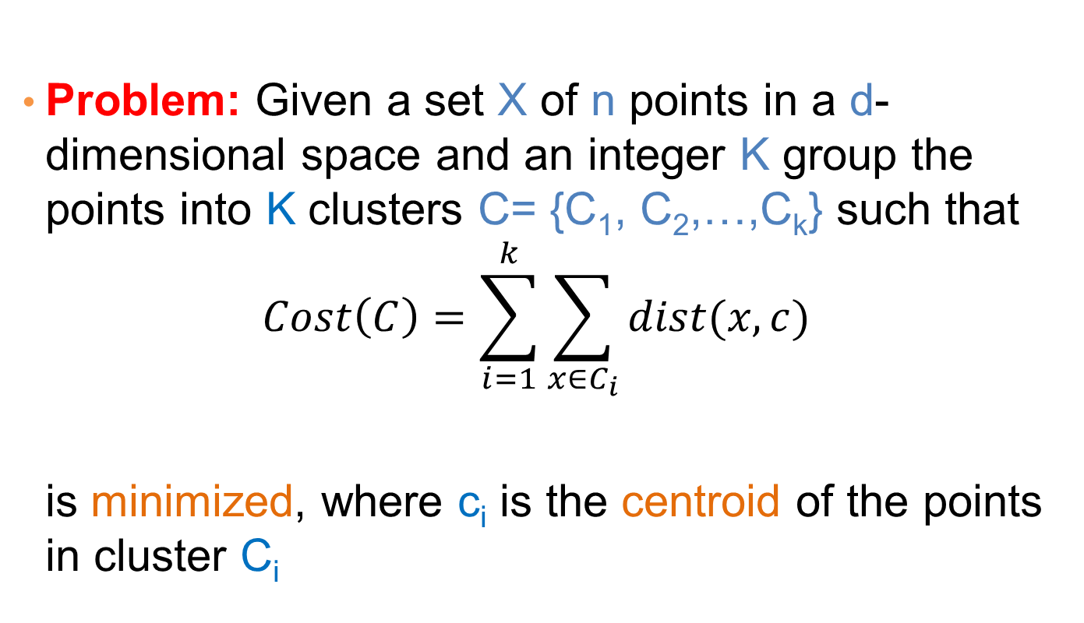
K-means Clustering
Problem: Given a set X of n points in a d-dimensional space and an integer K group the points into K clusters C= {C₁, C₂,…,C_{k}} such that
$$Cost\left(C\right)=\sum_{i=1}^{k}{\sum_{x∈C_{i}}{dist(x,c)}}$$
is minimized, where c_{i} is the centroid of the points in cluster C_{i}

Slide 20
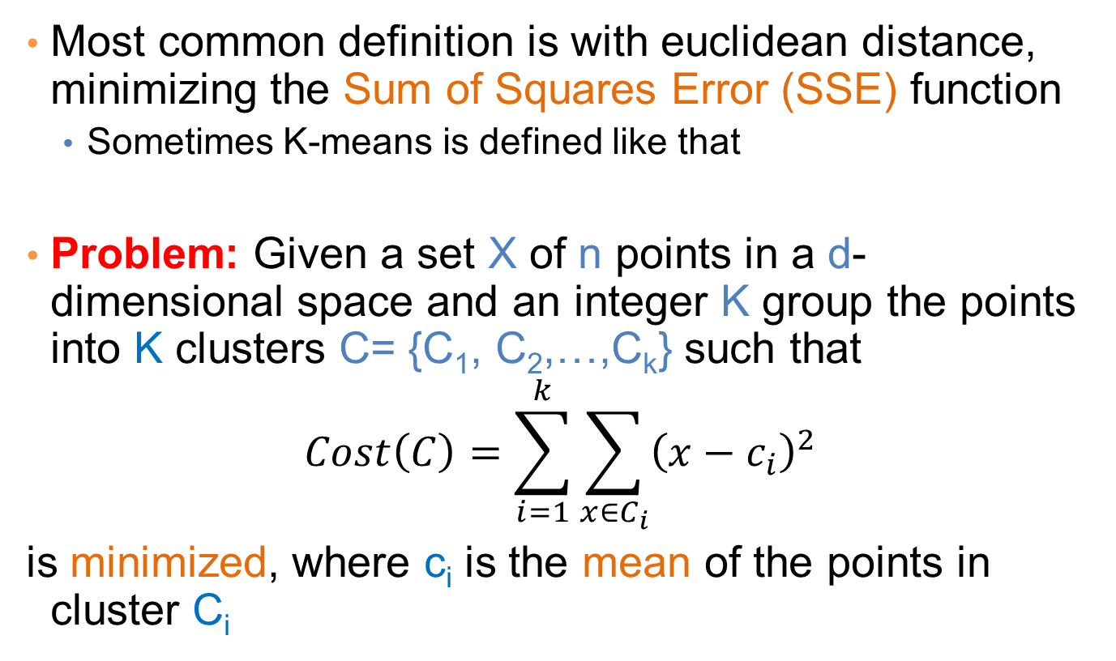
K-means Clustering
Most common definition is with euclidean distance, minimizing the Sum of Squares Error (SSE) function
Sometimes K-means is defined like that
Problem: Given a set X of n points in a d-dimensional space and an integer K group the points into K clusters C= {C₁, C₂,…,C_{k}} such that
$$Cost\left(C\right)=\sum_{i=1}^{k}{\sum_{x∈C_{i}}{{\left(x−c_{i}\right)}^{2}}}$$
is minimized, where c_{i} is the mean of the points in cluster C_{i}
Sum of Squares Error (SSE)

Slide 21
Complexity of the k-means problem
NP-hard if the dimensionality of the data is at least 2 (d≥2)
Finding the best solution in polynomial time is infeasible
For d=1 the problem is solvable in polynomial time (how?)
A simple iterative algorithm works quite well in practice

Slide 22
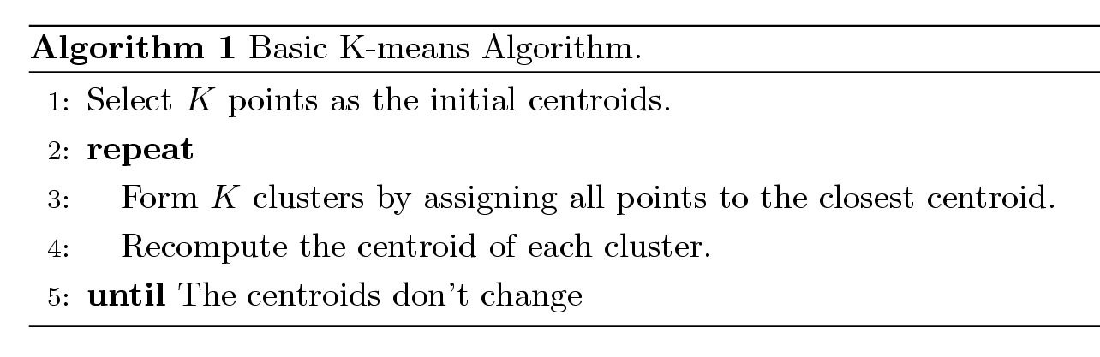
K-means Algorithm
Also known as Lloyd’s algorithm.
K-means is sometimes synonymous with this algorithm

Slide 23
K-means Algorithm – Initialization
Initial centroids are often chosen randomly.
Clusters produced vary from one run to another.

Slide 24
Two different K-means Clusterings
Original Points
Optimal Clustering
Sub-optimal Clustering

Slide 25
Importance of Choosing Initial Centroids

Slide 26
Importance of Choosing Initial Centroids

Slide 27
Importance of Choosing Initial Centroids

Slide 28
Importance of Choosing Initial Centroids …

Slide 29
Dealing with Initialization
Do multiple runs and select the clustering with the smallest error
Select original set of points by methods other than random . E.g., pick the most distant (from each other) points as cluster centers (K-means++ algorithm)

Slide 30
K-means Algorithm – Centroids
The centroid depends on the distance function
The minimizer for the distance function
‘Closeness’ is measured by Euclidean distance (SSE), cosine similarity, correlation, etc.
Centroid:
The mean of the points in the cluster for SSE, and cosine similarity
The median for Manhattan distance.
Finding the centroid is not always easy
It can be an NP-hard problem for some distance functions
E.g., median form multiple dimensions

Slide 31
K-means Algorithm – Convergence
K-means will converge for common similarity measures mentioned above.
Most of the convergence happens in the first few iterations.
Often the stopping condition is changed to ‘Until relatively few points change clusters’
Complexity is O( n * K * I * d )
n = number of points, K = number of clusters, I = number of iterations, d = dimensionality
In general a fast and efficient algorithm

Slide 32
Limitations of K-means
K-means has problems when clusters are of different
Sizes
Densities
Non-globular shapes
K-means has problems when the data contains outliers.

Slide 33
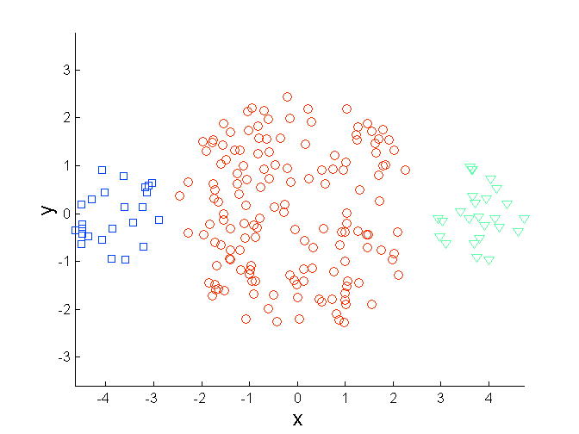
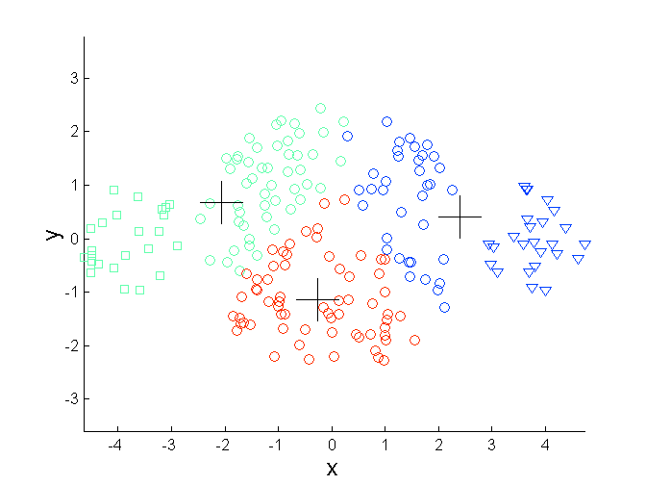
Limitations of K-means: Differing Sizes
Original Points
K-means (3 Clusters)

Slide 34
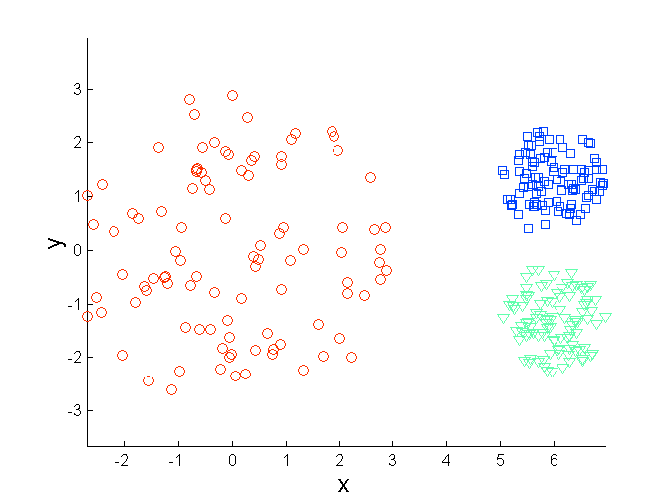
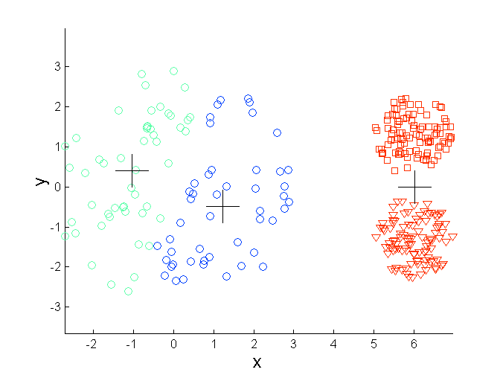
Limitations of K-means: Differing Density
Original Points
K-means (3 Clusters)

Slide 35
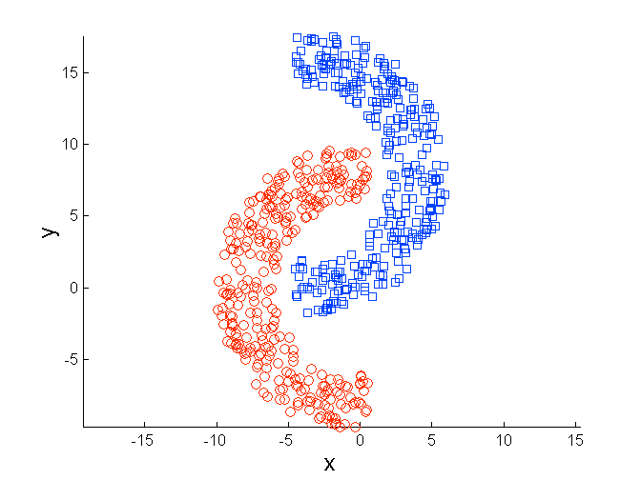
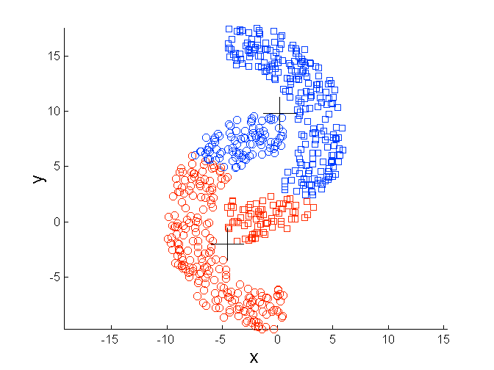
Limitations of K-means: Non-globular Shapes
Original Points
K-means (2 Clusters)

Slide 36
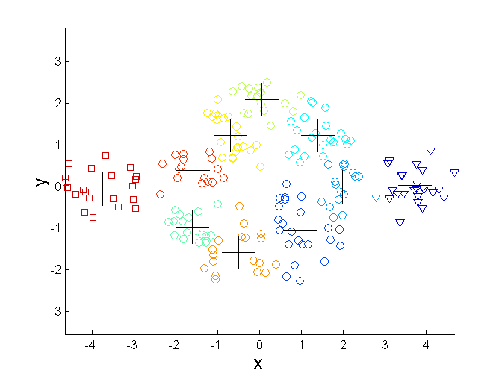
Overcoming K-means Limitations
Original Points K-means Clusters
One solution is to use many clusters.
Find parts of clusters, but need to put together.

Slide 37
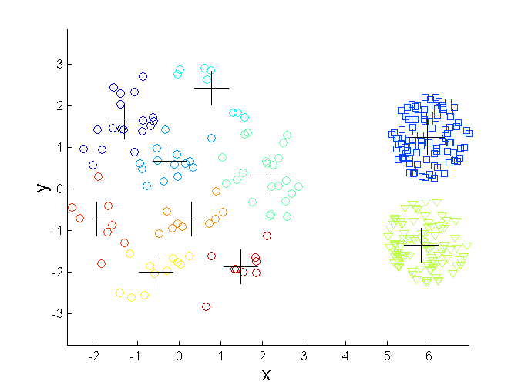
Overcoming K-means Limitations
Original Points K-means Clusters

Slide 38
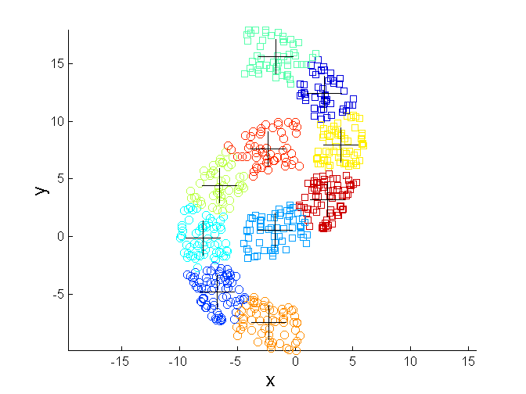
Overcoming K-means Limitations
Original Points K-means Clusters

Slide 39
Variations
K-medoids: Similar problem definition as in K-means, but the centroid of the cluster is defined to be one of the points in the cluster (the medoid).
K-centers: Similar problem definition as in K-means, but the goal now is to minimize the maximum diameter of the clusters (diameter of a cluster is maximum distance between any two points in the cluster).

Slide 40
HIERARCHICAL CLUSTERING

Slide 41
Hierarchical Clustering
Two main types of hierarchical clustering
Agglomerative:
Start with the points as individual clusters
At each step, merge the closest pair of clusters until only one cluster (or k clusters) left
Divisive:
Start with one, all-inclusive cluster
At each step, split a cluster until each cluster contains a point (or there are k clusters)
Traditional hierarchical algorithms use a similarity or distance matrix
Merge or split one cluster at a time

Slide 42
Hierarchical Clustering
Produces a set of nested clusters organized as a hierarchical tree
Can be visualized as a dendrogram
A tree like diagram that records the sequences of merges or splits

Slide 43
Strengths of Hierarchical Clustering
Do not have to assume any particular number of clusters
Any desired number of clusters can be obtained by ‘cutting’ the dendogram at the proper level
They may correspond to meaningful taxonomies
Example in biological sciences (e.g., animal kingdom, phylogeny reconstruction, …)

Slide 44
Agglomerative Clustering Algorithm
More popular hierarchical clustering technique
Basic algorithm is straightforward
Compute the proximity matrix
Let each data point be a cluster
Repeat
Merge the two closest clusters
Update the proximity matrix
Until only a single cluster remains
Key operation is the computation of the proximity of two clusters
Different approaches to defining the distance between clusters distinguish the different algorithms

Slide 45
Starting Situation
Start with clusters of individual points and a proximity matrix
p1
p2
p3
p4
p5
. . .
p1
p2
p3
p4
p5
.
.
.
Proximity Matrix

Slide 46
Intermediate Situation
After some merging steps, we have some clusters
C1
C2
C3
C4
C5
C1
C2
C3
C3
C4
C4
C5
C1
Proximity Matrix
C2
C5

Slide 47
Intermediate Situation
We want to merge the two closest clusters (C2 and C5) and update the proximity matrix.
C1
C2
C3
C4
C5
C1
C2
C3
C3
C4
C4
C5
Proximity Matrix
C1
C2
C5

Slide 48
After Merging
The question is “How do we update the proximity matrix?”
C2 U C5
C1
C3
C4
C1
?
C2 U C5
? ? ? ?
C3
C3
?
C4
C4
?
C1
Proximity Matrix
C2 U C5

Slide 49
How to Define Inter-Cluster Similarity
p1
p2
p3
p4
p5
. . .
p1
Similarity?
p2
p3
p4
p5
MIN
MAX
Group Average
Distance Between Centroids
Other methods driven by an objective function
Ward’s Method uses squared error
.
.
.
Proximity Matrix

Slide 50
How to Define Inter-Cluster Similarity
p1
p2
p3
p4
p5
. . .
p1
p2
p3
p4
p5
MIN
MAX
Group Average
Distance Between Centroids
Other methods driven by an objective function
Ward’s Method uses squared error
.
.
.
Proximity Matrix

Slide 51
How to Define Inter-Cluster Similarity
p1
p2
p3
p4
p5
. . .
p1
p2
p3
p4
p5
MIN
MAX
Group Average
Distance Between Centroids
Other methods driven by an objective function
Ward’s Method uses squared error
.
.
.
Proximity Matrix

Slide 52
How to Define Inter-Cluster Similarity
p1
p2
p3
p4
p5
. . .
p1
p2
p3
p4
p5
MIN
MAX
Group Average
Distance Between Centroids
Other methods driven by an objective function
Ward’s Method uses squared error
.
.
.
Proximity Matrix

Slide 53
How to Define Inter-Cluster Similarity
p1
p2
p3
p4
p5
. . .
p1
×
×
p2
p3
p4
p5
MIN
MAX
Group Average
Distance Between Centroids
Other methods driven by an objective function
Ward’s Method uses squared error
.
.
.
Proximity Matrix

Slide 54
Single Link – Complete Link
Another way to view the processing of the hierarchical algorithm is that we create links between the elements in order of increasing distance
The MIN – Single Link, will merge two clusters when a single pair of elements is linked
The MAX – Complete Linkage will merge two clusters when all pairs of elements have been linked.

Slide 55
Hierarchical Clustering: MIN
 | 1 | 2 | 3 | 4 | 5 | 6
1 | 0 | .24 | .22 | .37 | .34 | .23
2 | .24 | 0 | .15 | .20 | .14 | .25
3 | .22 | .15 | 0 | .15 | .28 | .11
4 | .37 | .20 | .15 | 0 | .29 | .22
5 | .34 | .14 | .28 | .29 | 0 | .39
6 | .23 | .25 | .11 | .22 | .39 | 0
 | 1 | 2 | 3 | 4 | 5 | 6
1 | 0 | .24 | .22 | .37 | .34 | .23
2 | .24 | 0 | .15 | .20 | .14 | .25
3 | .22 | .15 | 0 | .15 | .28 | .11
4 | .37 | .20 | .15 | 0 | .29 | .22
5 | .34 | .14 | .28 | .29 | 0 | .39
6 | .23 | .25 | .11 | .22 | .39 | 0
 | 1 | 2 | 3 | 4 | 5 | 6
1 | 0 | .24 | .22 | .37 | .34 | .23
2 | .24 | 0 | .15 | .20 | .14 | .25
3 | .22 | .15 | 0 | .15 | .28 | .11
4 | .37 | .20 | .15 | 0 | .29 | .22
5 | .34 | .14 | .28 | .29 | 0 | .39
6 | .23 | .25 | .11 | .22 | .39 | 0
 | 1 | 2 | 3 | 4 | 5 | 6
1 | 0 | .24 | .22 | .37 | .34 | .23
2 | .24 | 0 | .15 | .20 | .14 | .25
3 | .22 | .15 | 0 | .15 | .28 | .11
4 | .37 | .20 | .15 | 0 | .29 | .22
5 | .34 | .14 | .28 | .29 | 0 | .39
6 | .23 | .25 | .11 | .22 | .39 | 0
 | 1 | 2 | 3 | 4 | 5 | 6
1 | 0 | .24 | .22 | .37 | .34 | .23
2 | .24 | 0 | .15 | .20 | .14 | .25
3 | .22 | .15 | 0 | .15 | .28 | .11
4 | .37 | .20 | .15 | 0 | .29 | .22
5 | .34 | .14 | .28 | .29 | 0 | .39
6 | .23 | .25 | .11 | .22 | .39 | 0
 | 1 | 2 | 3 | 4 | 5 | 6
1 | 0 | .24 | .22 | .37 | .34 | .23
2 | .24 | 0 | .15 | .20 | .14 | .25
3 | .22 | .15 | 0 | .15 | .28 | .11
4 | .37 | .20 | .15 | 0 | .29 | .22
5 | .34 | .14 | .28 | .29 | 0 | .39
6 | .23 | .25 | .11 | .22 | .39 | 0
5
1
3
5
2
1
2
3
6
4
4
Nested Clusters
Dendrogram

Slide 56
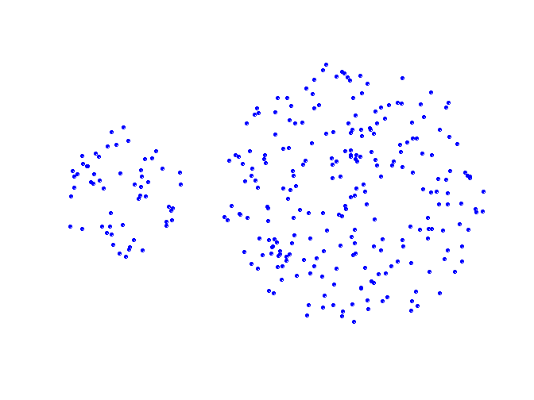
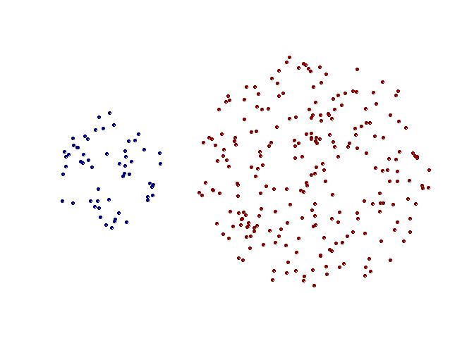
Strength of MIN
Original Points
Two Clusters
Can handle non-elliptical shapes

Slide 57
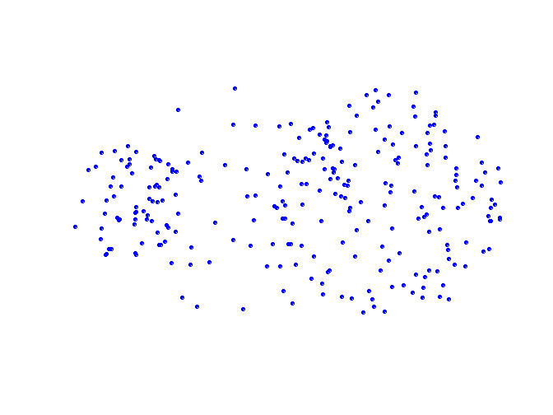
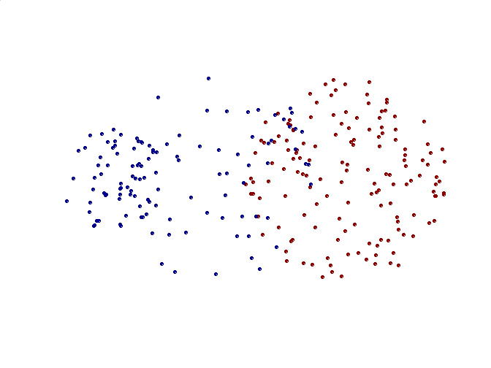
Limitations of MIN
Original Points
Two Clusters
Sensitive to noise and outliers

Slide 58
Hierarchical Clustering: MAX
 | 1 | 2 | 3 | 4 | 5 | 6
1 | 0 | .24 | .22 | .37 | .34 | .23
2 | .24 | 0 | .15 | .20 | .14 | .25
3 | .22 | .15 | 0 | .15 | .28 | .11
4 | .37 | .20 | .15 | 0 | .29 | .22
5 | .34 | .14 | .28 | .29 | 0 | .39
6 | .23 | .25 | .11 | .22 | .39 | 0
 | 1 | 2 | 3 | 4 | 5 | 6
1 | 0 | .24 | .22 | .37 | .34 | .23
2 | .24 | 0 | .15 | .20 | .14 | .25
3 | .22 | .15 | 0 | .15 | .28 | .11
4 | .37 | .20 | .15 | 0 | .29 | .22
5 | .34 | .14 | .28 | .29 | 0 | .39
6 | .23 | .25 | .11 | .22 | .39 | 0
 | 1 | 2 | 3 | 4 | 5 | 6
1 | 0 | .24 | .22 | .37 | .34 | .23
2 | .24 | 0 | .15 | .20 | .14 | .25
3 | .22 | .15 | 0 | .15 | .28 | .11
4 | .37 | .20 | .15 | 0 | .29 | .22
5 | .34 | .14 | .28 | .29 | 0 | .39
6 | .23 | .25 | .11 | .22 | .39 | 0
 | 1 | 2 | 3 | 4 | 5 | 6
1 | 0 | .24 | .22 | .37 | .34 | .23
2 | .24 | 0 | .15 | .20 | .14 | .25
3 | .22 | .15 | 0 | .15 | .28 | .11
4 | .37 | .20 | .15 | 0 | .29 | .22
5 | .34 | .14 | .28 | .29 | 0 | .39
6 | .23 | .25 | .11 | .22 | .39 | 0
 | 1 | 2 | 3 | 4 | 5 | 6
1 | 0 | .24 | .22 | .37 | .34 | .23
2 | .24 | 0 | .15 | .20 | .14 | .25
3 | .22 | .15 | 0 | .15 | .28 | .11
4 | .37 | .20 | .15 | 0 | .29 | .22
5 | .34 | .14 | .28 | .29 | 0 | .39
6 | .23 | .25 | .11 | .22 | .39 | 0
4
1
2
5
5
2
3
6
3
1
4
Nested Clusters
Dendrogram

Slide 59
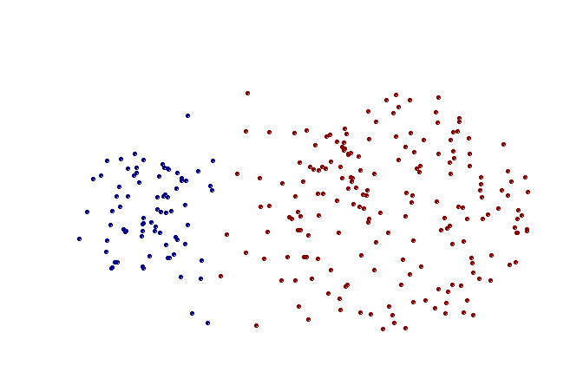
Strength of MAX
Original Points
Two Clusters
Less susceptible to noise and outliers

Slide 60
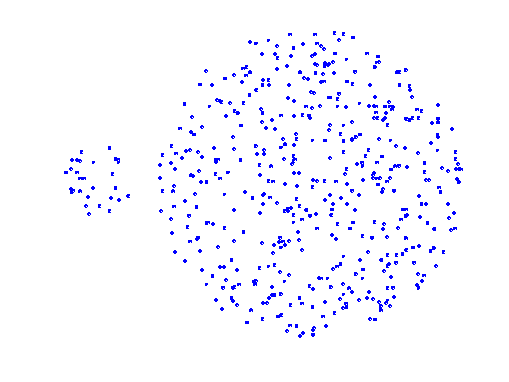
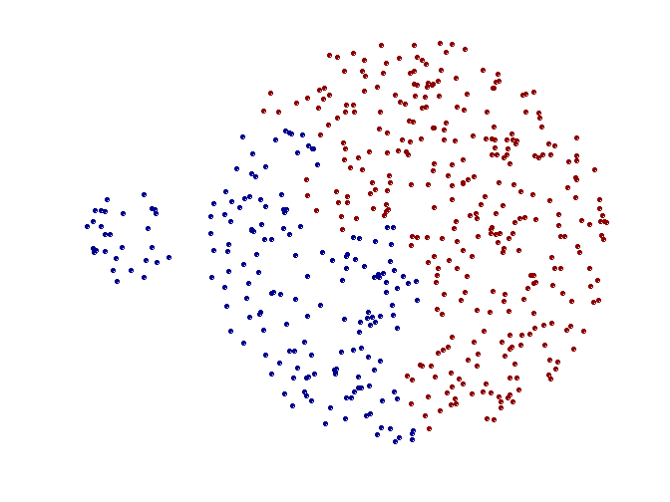
Limitations of MAX
Original Points
Two Clusters
Tends to break large clusters
Biased towards globular clusters

Slide 61
Cluster Similarity: Group Average
Proximity of two clusters is the average of pairwise proximity between points in the two clusters.
Need to use average connectivity for scalability since total proximity favors large clusters
 | 1 | 2 | 3 | 4 | 5 | 6
1 | 0 | .24 | .22 | .37 | .34 | .23
2 | .24 | 0 | .15 | .20 | .14 | .25
3 | .22 | .15 | 0 | .15 | .28 | .11
4 | .37 | .20 | .15 | 0 | .29 | .22
5 | .34 | .14 | .28 | .29 | 0 | .39
6 | .23 | .25 | .11 | .22 | .39 | 0

Slide 62
Hierarchical Clustering: Group Average
 | 1 | 2 | 3 | 4 | 5 | 6
1 | 0 | .24 | .22 | .37 | .34 | .23
2 | .24 | 0 | .15 | .20 | .14 | .25
3 | .22 | .15 | 0 | .15 | .28 | .11
4 | .37 | .20 | .15 | 0 | .29 | .22
5 | .34 | .14 | .28 | .29 | 0 | .39
6 | .23 | .25 | .11 | .22 | .39 | 0
5
4
1
2
5
2
3
6
1
4
3
Nested Clusters
Dendrogram

Slide 63
Hierarchical Clustering: Group Average
Compromise between Single and Complete Link
Strengths
Less susceptible to noise and outliers
Limitations
Biased towards globular clusters

Slide 64
Cluster Similarity: Ward’s Method
Similarity of two clusters is based on the increase in squared error (SSE) when two clusters are merged
Similar to group average if distance between points is distance squared
Less susceptible to noise and outliers
Biased towards globular clusters
Hierarchical analogue of K-means
Can be used to initialize K-means

Slide 65
Hierarchical Clustering: Comparison
5
1
4
1
3
2
5
5
5
2
1
MIN
2
MAX
2
3
6
3
3
6
1
4
4
4
5
5
1
4
1
2
2
5
2
Ward’s Method
5
2
3
6
Group Average
3
3
6
4
1
1
4
4
3

Slide 66
Hierarchical Clustering: Time and Space requirements
O(N²) space since it uses the proximity matrix.
N is the number of points.
O(N³) time in many cases
There are N steps and at each step the size, N², proximity matrix must be updated and searched
Complexity can be reduced to O(N² log(N) ) time for some approaches

Slide 67
Hierarchical Clustering: Problems and Limitations
Computational complexity in time and space
Once a decision is made to combine two clusters, it cannot be undone
No objective function is directly minimized
Different schemes have problems with one or more of the following:
Sensitivity to noise and outliers
Difficulty handling different sized clusters and convex shapes
Breaking large clusters

Slide 68
DBSCAN

Slide 69
DBSCAN: Density-Based Clustering
DBSCAN is a Density-Based Clustering algorithm
Reminder: In density based clustering we partition points into dense regions separated by not-so-dense regions.
Important Questions:
How do we measure density?
What is a dense region?
DBSCAN:
Density at point p: number of points within a circle of radius Eps
Dense Region: A circle of radius Eps that contains at least MinPts points

Slide 70
DBSCAN
Characterization of points
A point is a core point if it has more than a specified number of points (MinPts) within Eps
These points belong in a dense region and are at the interior of a cluster
A border point has fewer than MinPts within Eps, but is in the neighborhood of a core point.
A noise point is any point that is not a core point or a border point.

Slide 71
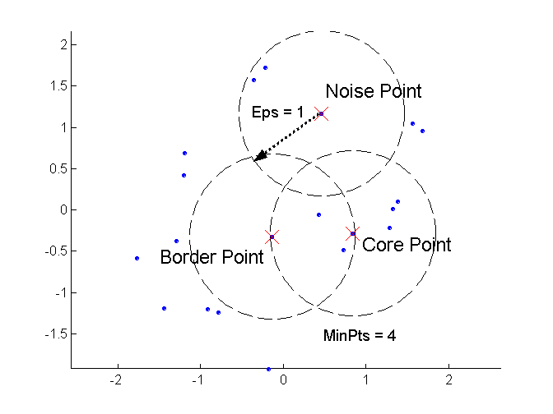
DBSCAN: Core, Border, and Noise Points

Slide 72
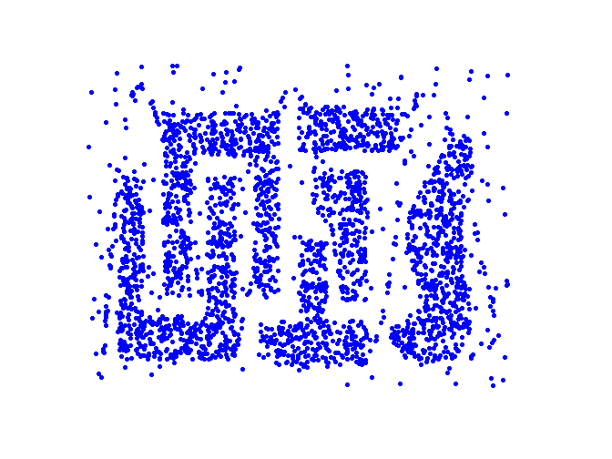
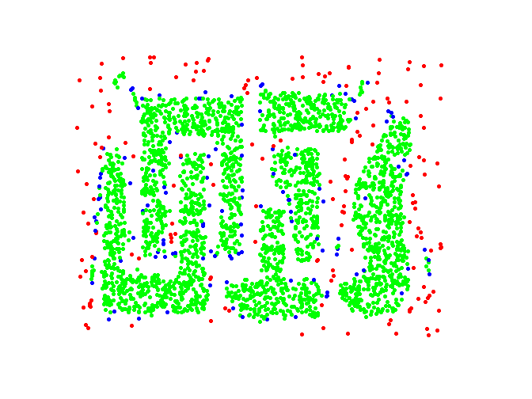
DBSCAN: Core, Border and Noise Points
Point types: core, border and noise
Original Points
Eps = 10, MinPts = 4

Slide 73
Density-Connected points
Density edge
We place an edge between two core points q and p if they are within distance Eps.
Density-connected
A point p is density-connected to a point q if there is a path of edges from p to q
p
p₁
q
p
q
o

Slide 74
DBSCAN Algorithm
Label points as core, border and noise
Eliminate noise points
For every core point p that has not been assigned to a cluster
Create a new cluster with the point p and all the points that are density-connected to p.
Assign border points to the cluster of the closest core point.

Slide 75
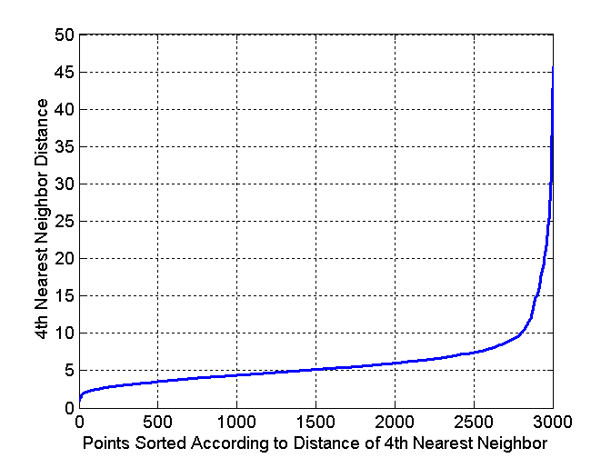
DBSCAN: Determining Eps and MinPts
Idea is that for points in a cluster, their k^{th} nearest neighbors are at roughly the same distance
Noise points have the k^{th} nearest neighbor at farther distance
So, plot sorted distance of every point to its k^{th} nearest neighbor
Find the distance d where there is a “knee” in the curve
Eps = d, MinPts = k
Eps ~ 7-10
MinPts = 4

Slide 76
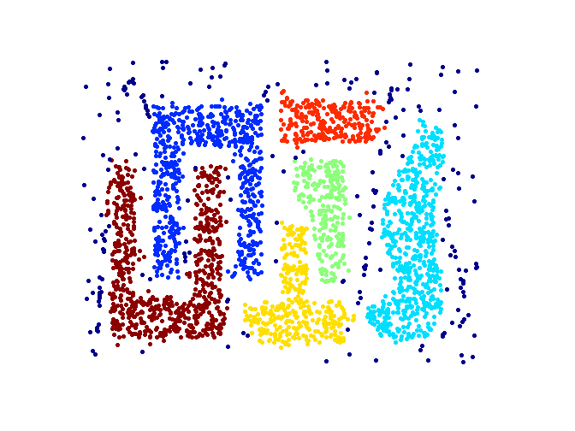
When DBSCAN Works Well
Original Points
Clusters
Resistant to Noise
Can handle clusters of different shapes and sizes

Slide 77
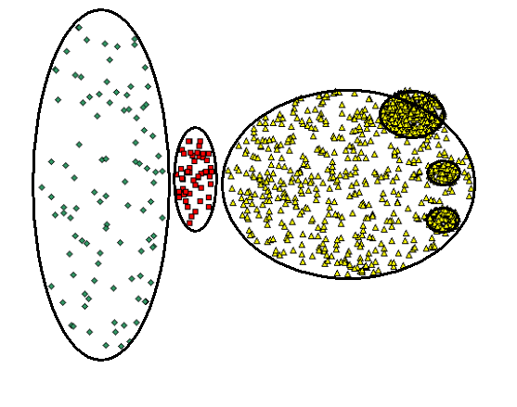
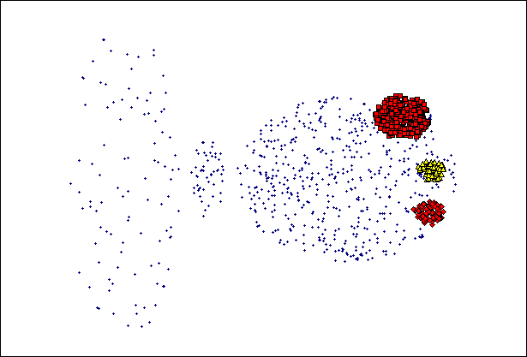
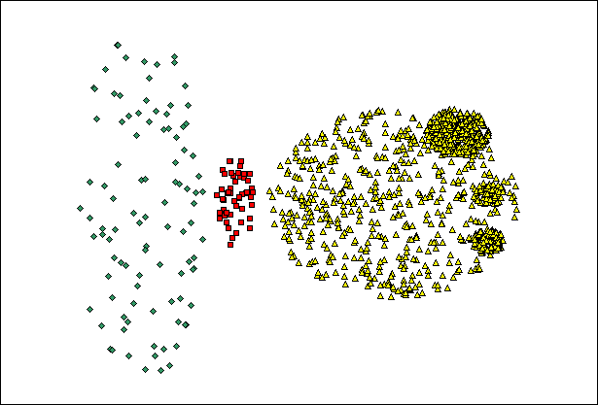
When DBSCAN Does NOT Work Well
(MinPts=4, Eps=9.75).
Original Points
Varying densities
High-dimensional data
(MinPts=4, Eps=9.92)

Slide 78
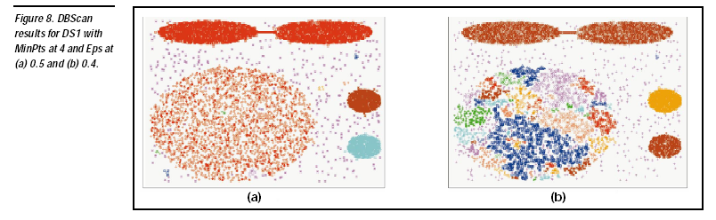

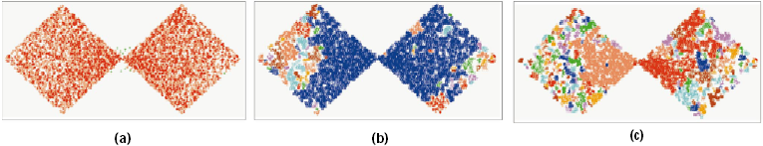
DBSCAN: Sensitive to Parameters

Slide 79
Other algorithms
PAM, CLARANS: Solutions for the k-medoids problem
BIRCH: Constructs a hierarchical tree that acts a summary of the data, and then clusters the leaves.
MST: Clustering using the Minimum Spanning Tree.
ROCK: clustering categorical data by neighbor and link analysis
LIMBO, COOLCAT: Clustering categorical data using information theoretic tools.
CURE: Hierarchical algorithm uses different representation of the cluster
CHAMELEON: Hierarchical algorithm uses closeness and interconnectivity for merging

